Slide 1
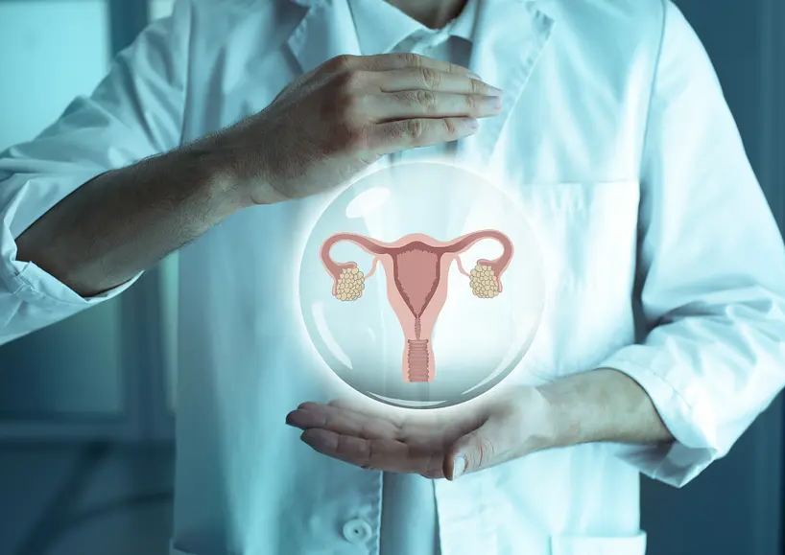

Abnormal Uterine Bleeding (AUB) Literature Review
Megan Macke BSN-RN, DNP-S
University of Mary
NUR 620 Care of Women & Children
Brittany Kudnra & Leah Neugebauer
February 4, 2024
Notes:
Image: Dehn, 2019

Slide 2
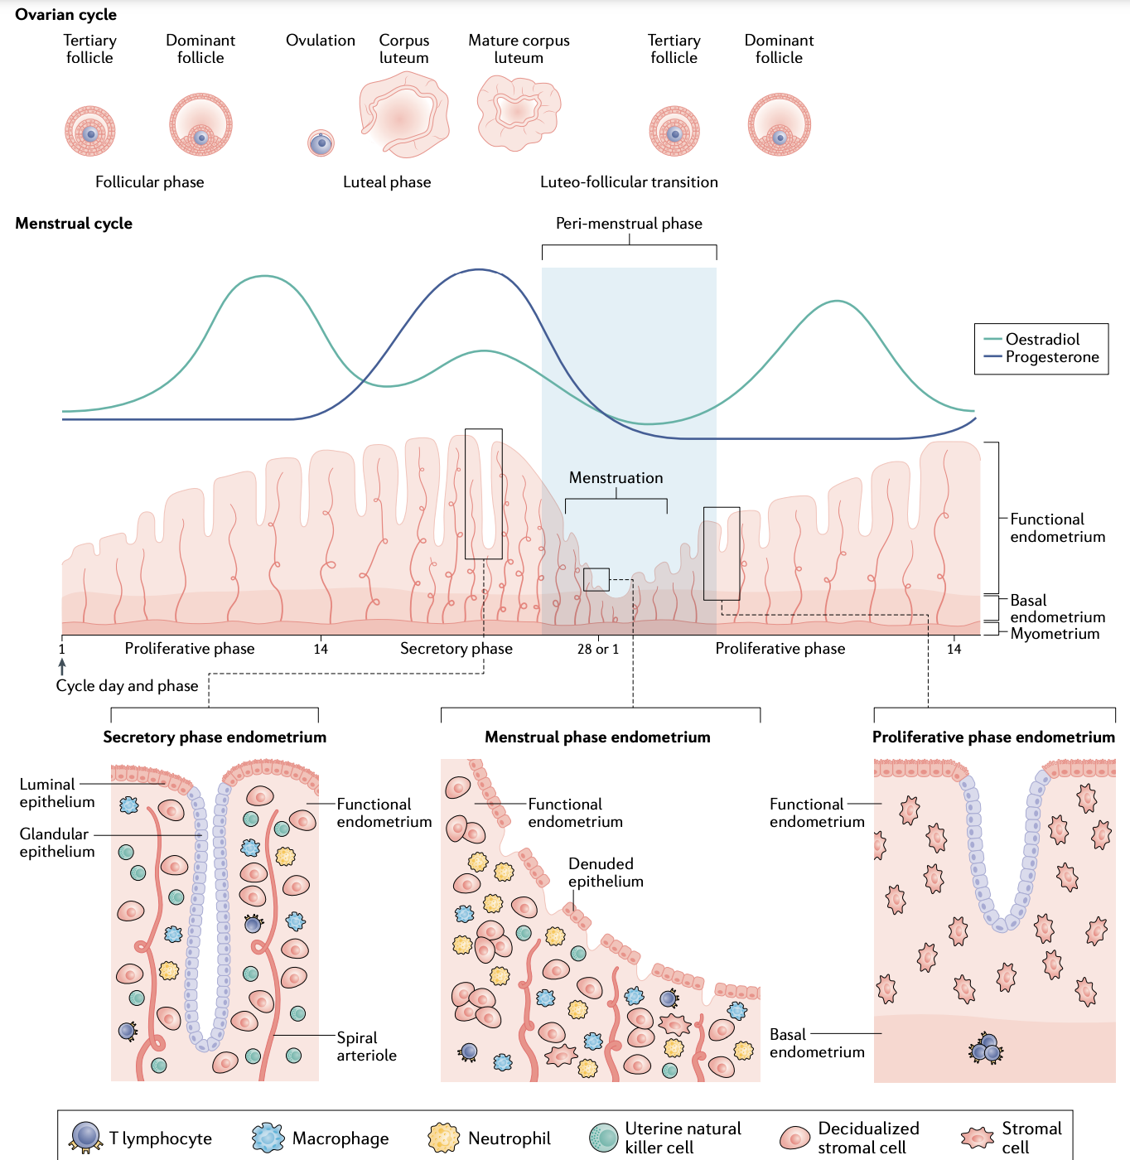
Introduction
Around 4 million annual visits in the United States are concerns around abnormal uterine bleeding
An estimated 30% of women of reproductive age are affected by abnormal uterine bleeding (Fehring et al, 2023)
Only about 5% of reproductive-aged women will see a doctor during any given year of their reproductive years for AUB.
Anovulation is accountable for 90% of AUB (Domino et al., 2023)
Abnormal uterine bleeding is a diagnosis given to a reproductive age individual when bleeding is irregular, not predictable, and not associated with premenstrual signs and symptoms that are usually present during ovulation (Casanova et al., 2019).
Notes:
Around 4 million annual visits in the United States are concerns around abnormal uterine bleeding
An estimated 30% of women of reproductive age are affected by abnormal uterine bleeding (Fehring et al, 2023)
Only about 5% of reproductive-aged women will see a doctor during any given year of their reproductive years for AUB.
Anovulation is accountable for 90% of AUB (Domino et al., 2023)
Abnormal uterine bleeding is a diagnosis given to a reproductive age individual when bleeding is irregular, not predictable, and not associated with premenstrual signs and symptoms that are usually present during ovulation (Casanova et al., 2019).
So with this literature review I did want to mention that any kind of bleeding after menopause is abnormal, so the main focus here will be abnormal bleeding present during the reproductive stage. ACOG defines abnormal uterine bleeding as:
Bleeding or spotting between periods
Bleeding or spotting after sex
Heavy bleeding during your period (soaking through 1 or more tampons every hour; bleeding that lasts more than 7 days).
Menstrual cycles that are shorts than 21 days or longer than 35 days
Cycle lengths that vary more than 7-9 days
Not having a period for 3-6 months
Bleeding after menopause (ACOG, n.d.)

Slide 3

Objectives
Brief pathophysiology of abnormal uterine bleeding
Common presentation and differential diagnoses
Red flags
Important points in the H&P
Management

Slide 4
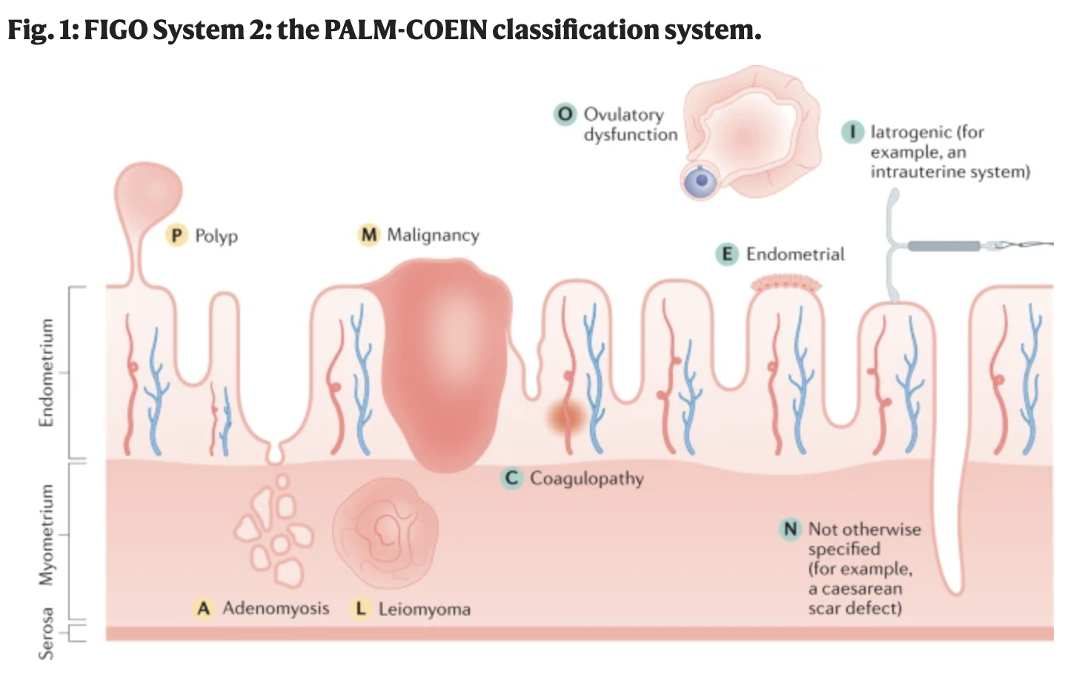
Pathophysiology AUB
Progesterone levels fall at the end of the menstrual cycle causing an enzymatic breakdown of the functionalis layer of the endometrium.
This breakdown is what causes blood loss and sloughing= menstruation
Platelets, thrombin, and vasoconstriction of the arteries in the endometrium have an effect of blood loss
What can cause AUB:
1. Structure deficits in the uterus: leiomyoma, polyps, adenomyosis, malignancy, trauma, or hyperplasia
2. Problems with clothing pathways (Willebrand disease)
3. Disruption in the hypothalamic-pituitary-ovarian axis (ovulatory or endocrine disorders ie:thyroid or PCOS) (Davis & Sparzak, 2023)
4. Medications like hormonal contraception and tamoxifen citrate, as well as intrauterine devices
5. Infection
Notes:
The international Federation of Gynecology and Obstetrics (FIGO) uses the classification system PALM-COEIN that breaks down abnormal uterine bleeding which is heavy menstrual bleeding or intermenstrual bleeding. PALM represents the structural causes of AUB: polyp, adenomyosis, leiomyoma, malignancy and hyperplasia– which can be evaluated or measured using imaging modalities or histopathology; COEI is the non-structural causes coagulopathy, ovulatory dysfunction, endometrial, iatrogenic– where imaging modalities and histopathology will not be helpful and the N standing for not yet classified
Coagulopathy issues are the cause of about 20% of patietns with heavy menstrual bleeding (Willebrand disease and thrombocytopenia are the most common)
Diseases that cause ovulatory dysfunction include hyperparthyrodisms, hypothyroidism, adnreal disorders, prolactinoma, PCOS, eating disorders
Medications are usually anticoagulants, steroids, tamoxifen, hormonal contraceptives, copper IUD, antipsychotic medications (mostly 1st gen), antiemetics (metoclopramide)

Slide 5
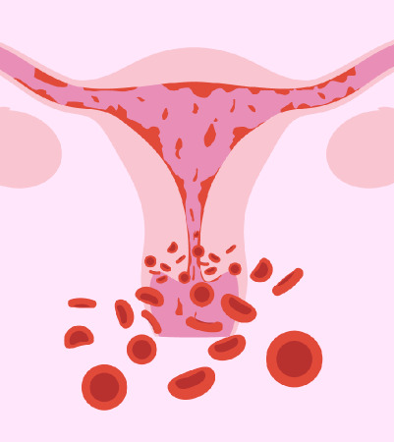
What we see as a most common presentation
Heavy menstrual bleeding is the most frequently seen presentation, however, still underreported.
Around 50 percent of the women who have abnormal uterine bleeding are anemic- which often presents with fatigue, decreased exercise capacity, headaches, and impaired cognition.
Common structural causes that lead to abnormal uterine bleeding include submucosal fibroids and endometrial polyps
It is important for us to ASK about bleeding and concerns. The menstrual cycle is considered to be the 5th vital sign.
Notes:
Heavy menstrual bleeding is the most frequently seen presentation, however, still underreported. It is defined as excessive menstrual blood loss that interferes with a woman’s physical, social, emotional and or material quality of life. HMB is the 4th most common reason for referral to OB-GYN, with about 20% of that population having to be seen by a specialist. In the following slides I will address questions that help distinguish this subjective assessment
Anemia is also present in about 50% of women who have abnormal uterine bleeding- presentation includes symptoms like fatigue, decreased exercise capacity, headaches, and impaired cognition
Structural causes can also be common reasons for abnormal uterine bleeding, the most common being submucosal fibroids and endometrial polyps. Myometrial conditions are more common in black women when compared to white women
It is important for us to ASK about bleeding and concerns. The menstrual cycle is considered to be the 5th vital sign.
Image: Narayana Health, 2023 (https://www.narayanahealth.org/blog/heavy-menstrual-bleeding-causes-symptoms-and-treatment-options/)

Slide 6
Potential differentials
Pregnancy complications: spontaneous abortion, ectopic pregnancy, placenta previa
Urinary Tract: infections or malignancy
Fallopian tubes and ovaries: pelvic inflammatory disease, malignancy
Cervix: benign growths, sexually transmitted infections, malignancy
Vagina: benign growths, sexually transmitted infections, vaginitis, malignancy, trauma, foreign bodies (Davis & Sparzak, 2023)
Urinary or gastrointestinal tract source bleeding

Slide 7

Red Flags
Significant hemorrhage causing acute anemia/hemodynamic instability
Replace volume with crystalloid and blood
Pad counts and clot size is helpful assessment to determine and monitor amount of bleeding.
Postmenopausal bleeding that occurs >1 year after last menstrual period: cancer must be ruled out
Hysterectomy is often indicated for endometrial cancer if medical therapy fails or if other uterine pathology is found
DVT signs and symptoms
Consider DVT prophylaxis if treating AUB with high-dose estrogens (Domino et al., 2023).
Pediatric considerations: foreign bodies, physical or sexual abuse, possible infections or signs of precocious puberty
Notes:
Image: USA Fibroid Center, 2023

Slide 8
Immediate actions needed
Acute abnormal uterine bleeding:
First line treatment is intravenous conjugated equine estrogen which stops bleeding withing 8hrs (or PO Premarin q6hrly should control bleeding within 12-24hrs)
Tranexamic acid TID
Intrauterine tamponade: fill a 26F foley bulb with 30ml saline
Uterine artery embolization if bleeding continues with medication therapy

Slide 9
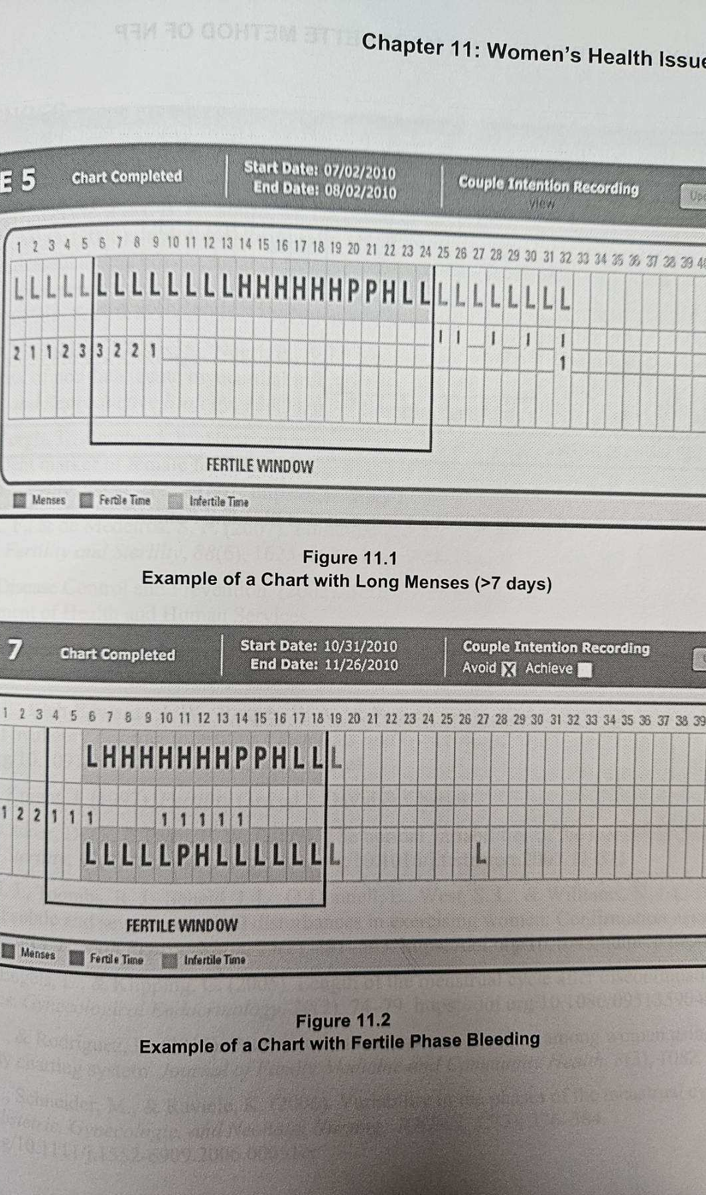
Nonurgent action needed:
Cycle tracking:
FACTS criteria and cycle tracking:
Overall length: IDEAL is 24-32 days (normal is 21-35 days) while keeping in mind that within 2-3 years of menarche it can range from 21-45
Menstrual period length: IDEAL is 3-6 days (normal is 2-7)
Cervical mucus phase: IDEAL 4-8 days (normal is 1-10 days)
Luteal phase: IDEAL 13-15 days (normal is 11-16) (FACTS, n.d.)
Notes:
Unusual bleeding is the term used in the Marquette method, also known as abnormal uterine bleeding is often related to the fertile phase (Fehring et al, 2023). With this, cycle tracking is an important nonurgent action needed as it can help distinguish further testing necessary to understand the etiology of the abnormal bleeding. Charting the menstrual cycle helps individuals understand a healthy cycle including length, bleeding, dry days, wet days, patterns and finally self discovery (FACTS, n.d.).
The image included on the right shows the top cycle tracking as an example of a long menses-more than 7 days, and the bottom is an example of fertile phase bleeding. This is just an example of abnormal uterine bleeding and why it can be useful in treatment.
Inclusion of the facts criteria and cycle tracking is overall length ideally being 24-32 days while normal is 21-35 and a longer range within the first 2-3 years of menarch; menstural period lenth is 3-6 days (normal is 2-7); cervical mucus phase ideally 4-8 days normal 1-10days, and luteral phase ideally 13-15 days with normal being 11-16 days.
Image: Fehring et al., 2023

Slide 10
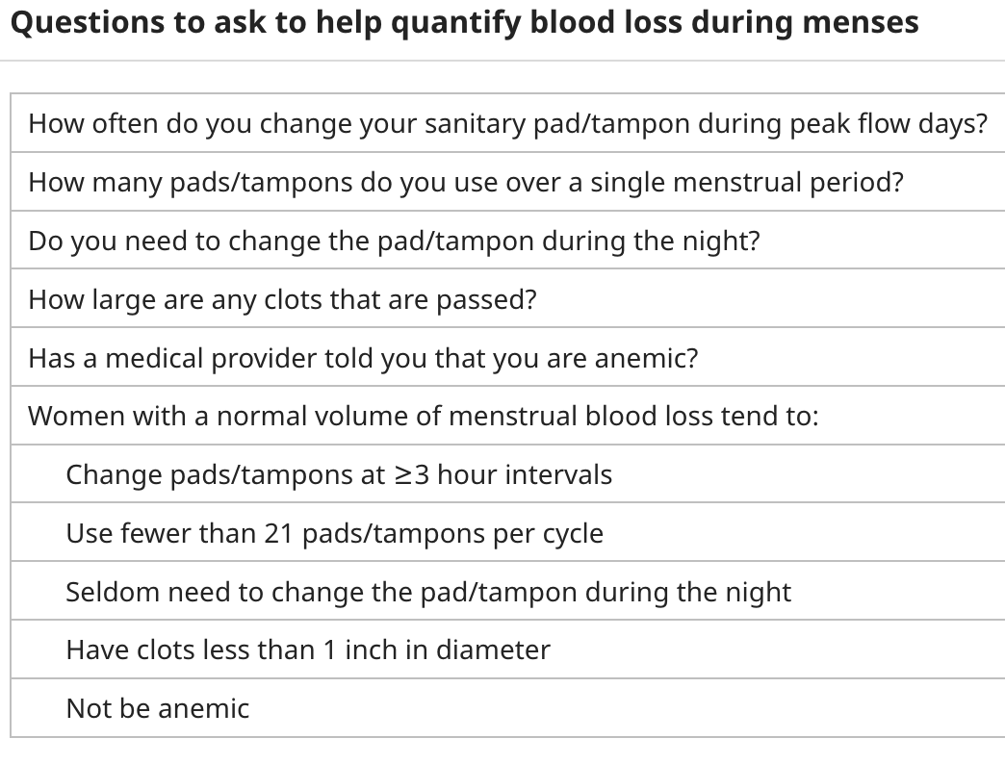
Important points in H&P
Menstrual history: onset, severity (quantity of pad/tampon use, and size of clots), cycle length (predictability), menopausal status
Coitus, contraception, weight loss/gain
Gynecologic history: gravidity and parity, STI history, previous Pap history and results.
These important points help GUIDE appropriate laboratory and radiologic testing
Notes:
It is important to ask patients about intermenstrual and postcoital bleeding.
Signs and symptoms of anemia, bleeding disorder, or endocrine disorders, current medications, family history, social history including impact of symptoms on quality of life, surgical history AND fertility desire
Bleeding is subjective, but with this table these questions can help quantify blood loss during menses
Physical exam would include a Pelvic exam with speculum and bimanual- noting size and contour of the uterus, limited mobility, or boggy. A pap smear if indicated, STI screening, and endometrial biopsy if indicated. While also keeping in mind other components of the physical exam that might lead the practitioner to the etiology like enlargement or tenderness of they thyroid, abnormal hair growth, moon face; bruising or petechiae that could lead to coagulopathy origin. Vitals including BMI and paleness are also important points in the physical exam.

Slide 11
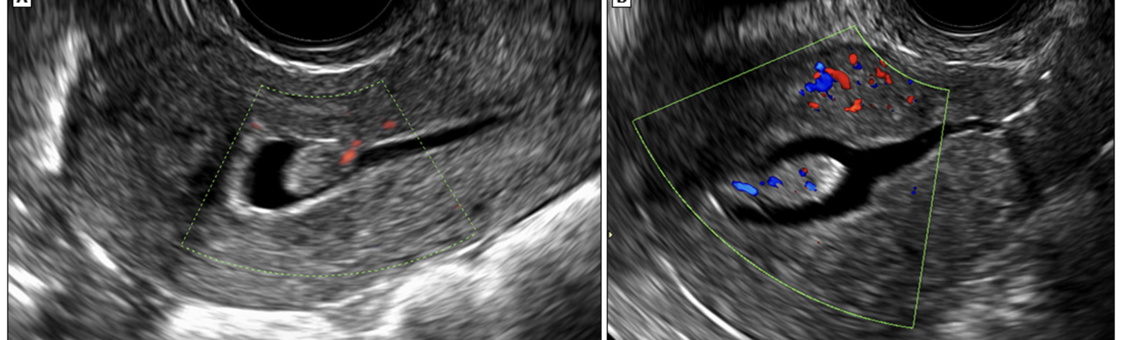
Diagnostics
ALL PATIENTS: urine hCG and CBC. If heavy bleeding is present a type and cross
Ferritin, coagulation panel, thyroid function tests, gonadotropins, and prolactin may also be indicated depending on the H&P.
Transvaginal ultrasound (1st line imaging study in most patients)
Hysteroscopy and sonohystergraphy
Endometrial biopsy (EMB)- 1st line for women >45 years
Notes:
Diagnostic testing that should be completed on ALL PATIENTS: include urine hCG and CBC. If heavy bleeding is present a type and cross
H&P will help breakdown further testing like Ferritin, coagulation panel, thyroid function tests, gonadotropins, and prolactin. Imaging may include transvaginal ultrasound, hysteroscopy or sonohystergraphy. The image is and example of a sonohysterogram of two different patients, both with an endometrial polyp- and doppler showing the flow to the polyp via feeding vessels (Kaunitz, 2024a). Endometrial biopsy is 1st line for women >45 years of age.
HMB undergo pelvic imaging to look for structural lesions, CBC to assess for anemia and thrombocytopenia, measurement of ferritin levels
Intermenstrual bleeding pelvic imaging is done to look for an endometrial polyp or cesarean scar defect and endometrial sampling to look for malignancy or endometritis
Irregular bleeding: lab are often ordered to evaluate for thyroid disease, hyperprolactinemnia, or premature ovarian insufficiency. Endometrial sampling is usually done with persistent symptoms of 6 months or more or increased risk of endometrial hyperplasia/neoplasia (Kaunitz, 2024a)

Slide 12
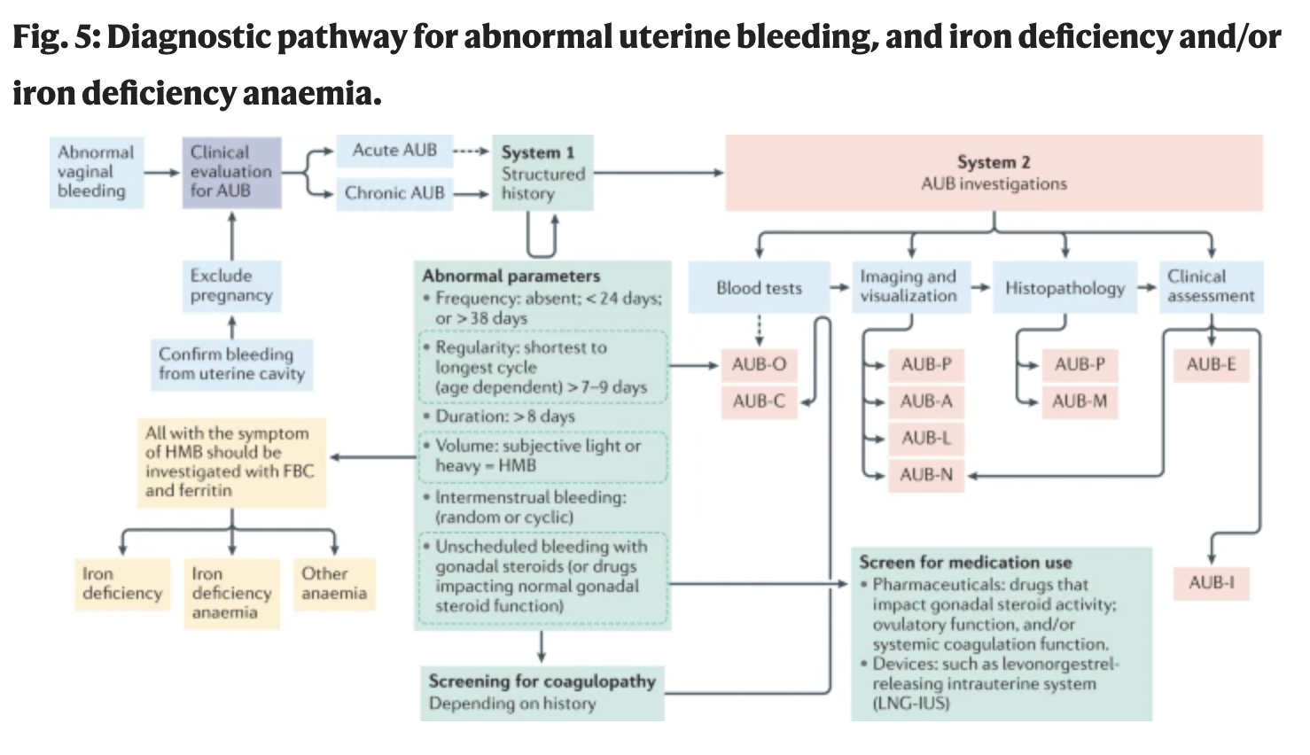
Diagnostic Criteria:
Notes:
Going into the diagnostic criteria- Jain et al. (2022) include this diagnostic pathway with the initial assessment of pregnancy along with determining if the bleeding is in fact coming from the uterus. Bleeding can be either acute or chronic. Understanding the International Federation of Gynecology and Obstetrics (the green boxes) which is the system 1 classification- helps the practitioner identify the cause/causes to then proceed with imaging or blood tests. FIGO has a system 2 classification (red boxes)

Slide 13
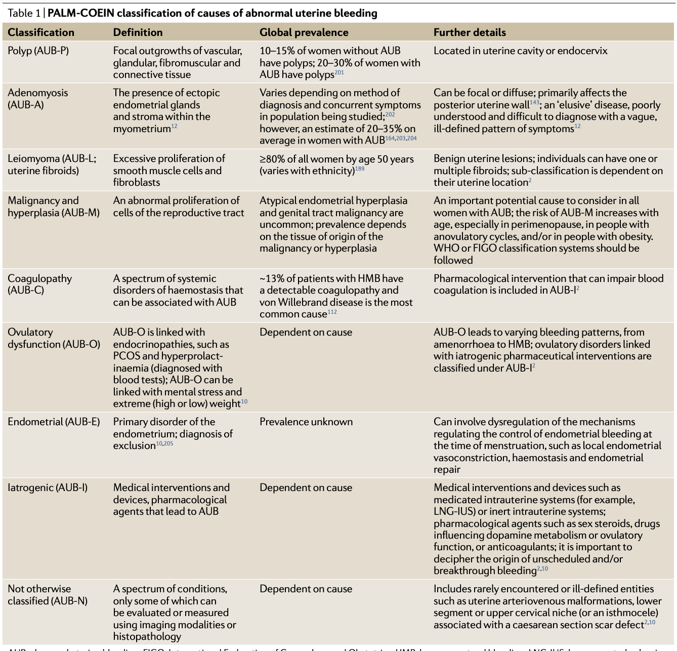
Management/Treatment Goals
Treatment depends on multiple factors- specifically the etiology of the AUB, wishes around fertility, and clinical stability of the patient.
GOAL: Evaluating and ruling out any serious conditions like malignancy, improving quality of life, and treating the patient around future fertility goals.
Notes:
Treatment depends on multiple factors- specifically the etiology of the AUB, wishes around fertility, and clinical stability of the patient. This image just goes more off of the previous diagnostic image just so you guys can see what it breaks down into
GOAL: Evaluating and ruling out any serious conditions like malignancy, improving quality of life, and treating the patient around future fertility goals. Management goals are to correct the underlying primary etiology, improve quality of life, prevent an acute episode of uterine bleeding, prevention or treatment of anemia, establishing a regular bleeding pattern, and preventing endometrial hyperplasia or carcinoma. It is found after a study done by the Royal College of Obstetricians and Gynecologists in the UK that the treatment for heavy menstural bleeding was around the symptoms rather than the underlying cause. The artificial suppression of ovarian sex steroid hormones does not help a woman with menstrual abnormalities- investigation and diagnosis need to be identified to personalize management. Most treatment is hormonal for AUB and can work for those with non-structural causes of AUB, but those with structural causes can have even more complications. Surgical treatment can be beneficials but it could temporarily or permanently impair fertility.
Image: Jain et al., 2022

Slide 14
COMPARE & CONTRAST
Fertility awareness based methods: Marquette method recommendations for intense or longer than usual menses: multivitamin with iron and NSAIDS; tail-end cycle bleeding is most likely due to hormonal issues and management includes the Harvard Fertility Diet and possible supplementation of progesterone (Ferhing et al., 2023)
Current best practice: The 1st line approach to most patients without a primary etiology for AUB is progestin-based treatments like combination oral contraceptives or 52mg levonorgestrel-releasing intrauterine device with alternatives being progestin-only oral medications (planning to conceive), nonhormonal therapies, or minimally invasive surgery (Kaunitz, 2024b)
Notes:
So this compare and contrast kind of bleeds into (No pun intended) the management of nonacute management. There are different ways to manage abnormal uterine bleeding especially when it comes to the fertile phase of the cycle.
Fertility awareness based methods like the Marquette method recommendation for intense or longer than usual menses: multivitamin with iron and NSAIDS; tail-end cycle bleeding is most likely due to hormonal issues and management includes the Harvard Fertility Diet and possible supplementation of progesterone (Ferhing et al., 2023)
NSAIDs may aid in decreasing the amount of blood loss. Non-hormonal treatment with anti-fibrinolytic and non-steroidal anti-inflammotry medications have been shown to reduce blood loss during menstruation by up to 50%. Ibuprofen is most commonly used, however Mobic is also a great choice and more effective for pain. (Jain et al, 2018)
-Targeted hormone assessment/profile can be utilized if the patient is tracking their cycle (FACTS, n.d.)
Current best practice 1st line approach to most patients without a primary etiology for AUB is progestin-based treatments like combination oral contraceptives or 52mg levonorgestrel-releasing intrauterine device with alternatives being progestin-only oral medications (planning to conceive), nonhormonal therapies, or minimally invasive surgery (Kaunitz, 2024b)
Oral contraceptives can be effective, but there is a lack of data from randomized trials. A levonorgestrel releasing IUD (merena) has been found to be most effective in improving quality of life for those dealing with heavy menstrual bleeding as their primary symptom with 71-95% decrease in blood loss. This can also be used in patients who are at increased risk for venous thromboembolism, like smoking or hypertension (Jain et al, 2018 & Kaunitz, 2024b).

Slide 15
Current Research
There is a lack of consistent terminology in the scientific community, thus abnormal uterine bleeding is to be used for consistency when defining abnormal in duration, frequency, regularity and volume. Menorrhagia, oligomenorrhea, and metrorrhagia are out of date terms. With this, validity of scientific research will improve.
Menstruation is affected by person experience, society, and culture. Research has found that there is a stigma around menstruation and if shame and embarrassment continue around this aspect of a woman’s health- menstruation is healthy- then medical care for AUB will continue to be underprovided (Jain et al, 2028).
NaPro technology: the goals of monitoring and maintaining reproductive and gynecological health with an aim in identifying the problem with medical and surgical treatments that COOPERATE with the reproductive system rather than working against it (FACTS, n.d.)
Notes:
First, I would just like to note that the article uterine bleeding: how understanding endometrial physiology underpins menstrual health is such a good read and so pertinent.
A lot of books are coming out at the moment about fertility awareness based methods, menstruation, and women’s health. This dynamic can help change culture around hiding a period, and push women to understand the normal and abnormals of menstruation and seek care when the abnormal is present.
FemTech is the term being used to describe devices, software, and technology that are utilized for women's health in hopes that diagnostic capability will increase around an increase in the personal menstrual health of the patients.
There is a lack of consistent terminology in the scientific community, thus abnormal uterine bleeding is to be used for consistency when defining abnormal in duration, frequency, regularity and volume. Menorrhagia, oligomenorrhea, and metrorrhagia are out of date terms. With this, validity of scientific research will improve.
Menstruation is affected by person experience, society, and culture. Research has found that there is a stigma around menstruation and if shame and embarrassment continue around this aspect of a woman’s health- menstruation is healthy- then medical care for AUB will continue to be underprovided (Jain et al, 2028).
NaPro technology: the goals of monitoring and maintaining reproductive and gynecological health with an aim in identifying the problem with medical and surgical treatments that COOPERATE with the reproductive system rather than working against it (FACTS, n.d.)

Slide 16
Patient Education
Shared decision making!
Birth control side effects
How to track your cycle
Notes:
Like we have been learning throughout this semester, it is incredibly important to provide an opportunity for education around informed/shared decision making. Research has proven that hormonal therapy like OCPs do not show as promising effects on abnormal uterine bleeding, while IUDs have more studies around them. Furthermore cycle charting and diving deeper into the etiology is necessary to find the root cause of AUB. It is important to educate patients on side effects of birth control like increased risk for DVTs, weight gain, increased risk for cancer, decreased libido, increased blood pressure, depression/anxiety. While not everyone experiences these they are important to educate patients on and different options for addressing a diagnosis of abnormal uterine bleeding.
Further education may revolve around surgical cases around AUB: it is important to educate patients that studies continue to come out around women who have had hysterectomies with ovarian conservation are at increased risk of cardiovascular and metabolic disease (including hyperlipidemia and coronary artery disease) when compared with the same cohort of women age and geographic location. The uterus has additional physiological functions beyond just reproduction.
Additional education would be around tracking one’s cycle and the different methods available, Marquette is what I mentioned most, but educating the patient on other options as well and supplying resources for that method along with referral if needed.

Slide 17
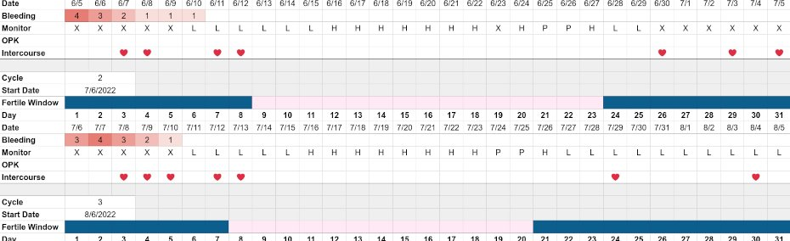
Follow-up
Regardless of hormonal or non-hormonal therapy for nonacute cases of AUB, the patient should keep a menstrual diary and document bleeding patterns in relationship to the therapy they are on.
In acute cases of AUB, follow-up evaluation should be done within 4-6 months (Domino et al., 2023).
Notes:
Image: NFPcharts.com, n.d.

Slide 18
Referral Criteria
Referral to a gynecologist for heavy bleeding, persistent bleeding despite treatment, concerns for malignancy, or if surgery is necessary.
Referral to hematologists for bleeding disorders
Referral to endocrinologist for thyroid management if the practitioner does not feel comfortable managing
Referral for education around FABM like the Marquette method
If there is no obvious cause for vaginal bleeding in a pediatric patient- referral to pediatric endocrinologist (Domino et al., 2023)
Notes:
Referral around abnormal uterine bleeding will depend on etiology and comfort level of treatment.

Slide 19
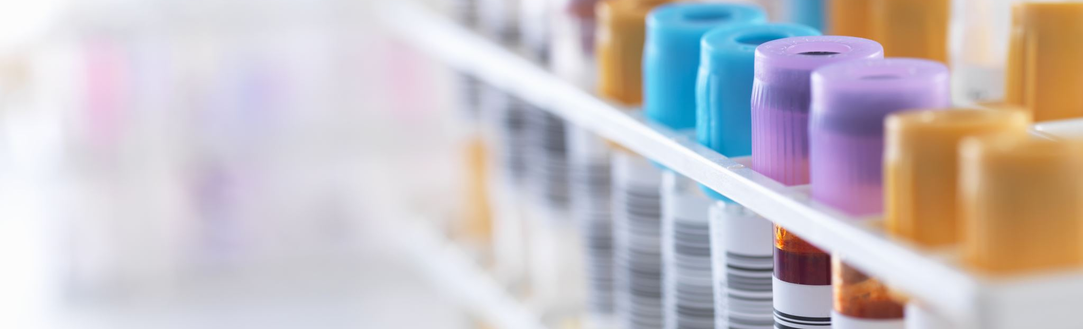
Conclusion
Complications of AUB include: anemia, infertility, and endometrial cancer
Do not use estrogen if suspicion for endometrial hyperplasia or carcinoma, history of DVT, migraines with aura, or smoking.
A pregnancy test and CBC should be done on all patients with suspected AUB
Etiology of bleeding is critical to treat underlying causes- PALM-COEIN acronym
AUB is under-reported so as practitioners it is super important for this 5th vital sign to be assessed.
FABM can help management and treatment of AUB
Notes:
Complications of AUB include: anemia, infertility, and endometrial cancer
Do not use estrogen if suspicion for endometrial hyperplasia or carcinoma, history of DVT, migraines with aura, or smoking.
A pregnancy test and CBC should be done on all patients with suspected AUB
Etiology of bleeding is critical to treat underlying causes- The international Federation of Gynecology and Obstetrics (FIGO) uses the classification system PALM-COEIN that breaks down abnormal uterine bleeding into structural and non-structural causes
AUB is under-reported so as practitioners it is super important for this 5th vital sign to be assessed using proper questions to assess bleeding patterns
FABMs and menstrual cycle charting can help with detection, prediction, diagnosis, and treatment of health problems around abnormal uterine bleeding.

Slide 20
References:
American College of Obstetricians and Gynecologists (ACOG). (n.d.). Abnormal uterine bleeding. https://www.acog.org/womens-health/faqs/abnormal-uterine-bleeding
American College of Obstetricians and Gynecologists (ACOG). (2024). Management of acute abnormal uterine bleeding in nonpregnant reproductive-aged women. https://www.acog.org/clinical/clinical-guidance/committee-opinion/articles/2013/04/management-of-acute-abnormal-uterine-bleeding-in-nonpregnant-reproductive-aged-women#:~:text=Medical%20management%20should%20be%20the,oral%20progestins%2C%20and%20tranexamic%20acid.
Casanova, R., Guang, A., Goepfert, A. R., Hueppchen, N. A., Weiss, P. M., Ling, F. W., P., H. W. N., Lube, D. W., & Smith, R. P. (2019). Beckmann and Ling Obstetrics and Gynecology (8th ed.). Wolters Kluwer.
Davis, E. & Sparzak, P. (2023). Abnormal uterine bleeding. National Library of Medicine. https://www.ncbi.nlm.nih.gov/books/NBK532913/
Dehn, B. (2019). Abnormal uterine bleeding in reproductive-aged women utilizing the PALM-COEIN system. Women’s Healthcare. https://www.npwomenshealthcare.com/abnormal-uterine-bleeding-in-reproductive-aged-women-utilizing-the-palm-coein-system/
Domino, F., Baldor, R., Barry, K., Golding, J., Stephens, M. (2023). The 5-minute clinical consult 2023 (31st edition). Wolters Kluwer
FACTS (n.d.). The female cycle as the fifth vital sign. FACTS about Fertility. [Video]. Retrieved January 17, 2024, from https://www.factsaboutfertility.org/topic/the-female-cycle-as-the-fifth-vital-sign-umary/
Fehring, R., Schneider, M. & Barron, M. L. (2023). Living with fertility: the Marquette method of nfp. Marquette University Institute for Natural Family Planning.
Jain, V., Chodankar, R. R., Maybin, J. A., & Critchley, H. O. D. (2022). Uterine bleeding: how understanding endometrial physiology underpins menstrual health. Nature Reviews. Endocrinology, 18(5), 290–308. https://doi-org.ezproxy.umary.edu/10.1038/s41574-021-00629-4
Kaunitz, A. (2024a). Abnormal uterine bleeding in nonpregnant reproductive-age patients: terminology, evaluation, and approach to diagnosis. UpToDate. https://www.uptodate.com/contents/abnormal-uterine-bleeding-in-nonpregnant-reproductive-age-patients-terminology-evaluation-and-approach-to-diagnosis?search=abnormal%20uterine%20bleeding&source=search_result&selectedTitle=1~150&usage_type=default&display_rank=1
Kaunitz, A. (2024b). Abnormal uterine bleeding in nonpregnant reproductive-age patients: management. UpToDate. https://www.uptodate.com/contents/abnormal-uterine-bleeding-in-nonpregnant-reproductive-age-patients-management?search=abnormal%20uterine%20bleeding&source=search_result&selectedTitle=2~150&usage_type=default&display_rank=2

